Slide 1
Requirement Management & Traceability Flow with New Proposals Proof of concept using a traffic light controller
Smriti Sharma & Surya Piplani
21st June 2024

Slide 2
Agenda
1.
Motivation & Objective
5.
Proposed Feature
2.
Introduction
6.
Proof of Concept
3.
Existing Methods
7.
What’s next with JAMA?
4.
Problems associated with Existing Methods

Slide 3
Objective
Motivation
Unmanageable Marketing requirements
Implementation review of the ADD requirements
Understand the current Requirement Management & Traceability flow
Find solutions to existing gaps
Develop a Proof of concept to showcase the solutions

Slide 4
INTRODUCTION

Slide 5
What is Requirement Traceability?
Definition and Importance
Requirement traceability is the ability to describe and follow the life of a requirement, in both a forwards and backwards direction, from its origins, through its development and specification, to its subsequent deployment and use.
Purpose of Traceability
It ensures that all requirements are:
properly addressed,
implemented, and
tested, and
it enables multi-disciplinary teams involved in product definition, design, risk evaluation, and verification to relate work items from different stages of development.

Slide 6
The Role of Requirement Traceability in Project Management
Optimize Systems Engineering Process
Reduce our customer’s time to market
Reduce Non-Value Time spent on administrative tasks
Fewer Defects, discovered early
Reduce Rework late in engineering cycle
Ease the path to functional safety compliance

Slide 7
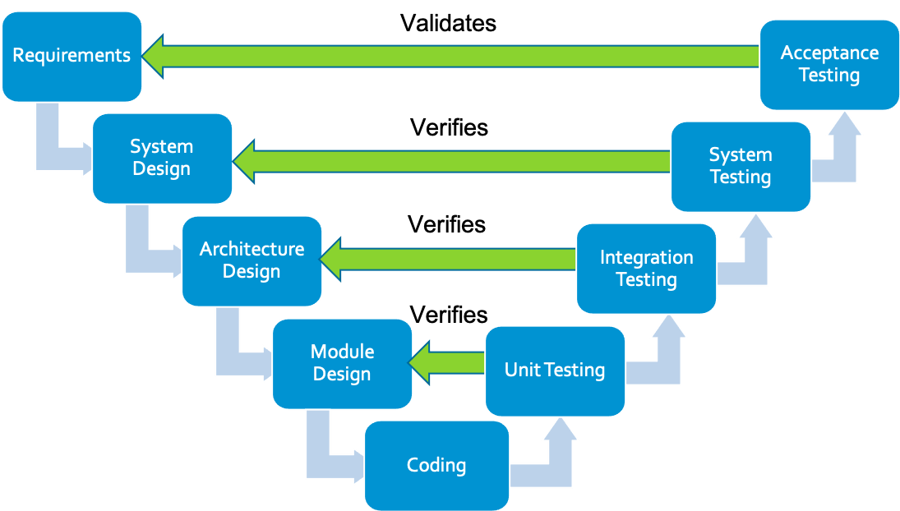
V curve Reference model
Left Side: Development
Requirements: Capture what's needed.
Design: Plan system structure.
Module Design: Detail components.
Bottom: Implementation
Coding: Build the system.
Right Side: Testing
Unit Test: Verify parts.
Integration Test: Check connections.
System Test: Validate whole system.
Acceptance Test: Confirm user fit.
Top: Maintenance
Support: Update and optimize

Slide 8
Existing Flow

Slide 9
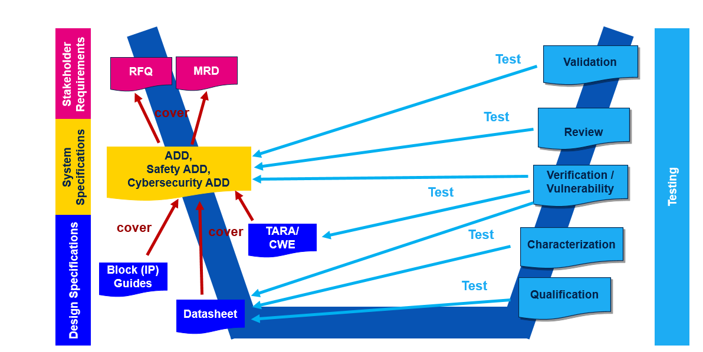
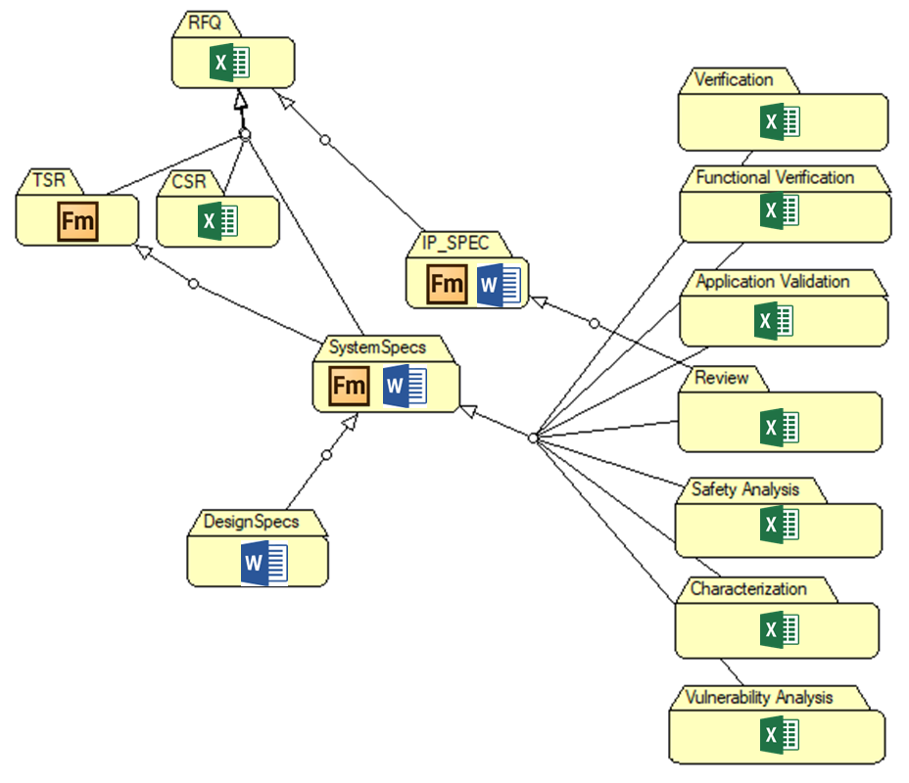
Documents to be released to customers: ADD and Datasheet → 100% of traceability coverage proof is needed
Block Guides and Datasheet linked to the ADD as additional info to complete the specification of ADD requirements
As consequence of previous statements: DS parameters to be covered by ADD or with direct tests (e.g. test program, validation, characterization)

Slide 10
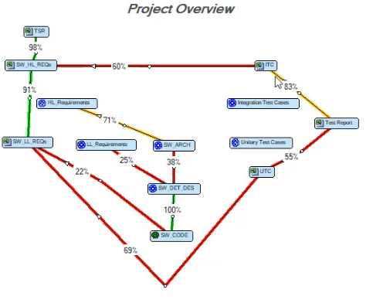
Current Flow Tools
MRD
ADD
Luca.N’s script to capture ADD tags & descriptions from ADD release mif/fm & dump into xls
XLS for capturing links
ADD to MRD –
Verif to ADD - syncs://apgs2ssync.s2s.tpa.agr.st.com:9559/Projects/stellar_P6/stellar_P6_doc/SAFETY/ReqTracer/Report/SR6P6_CUT1_TraceabilityMatrix.xls
4. Req Tracer: feed in these 2 xls’ columns into Req Tracer, which gives a coverage figure
5. BOM.txt – captures paths to MRD, ADD, all logs etc
syncs://apgs2ssync.s2s.tpa.agr.st.com:9559/Projects/stellar_P6/stellar_P6_doc/SAFETY/ReqTracer/SR6P6_cut1_ReqTracer_BOM.txt

Slide 11
Problems faced in the current flow
Multiple platforms are used to in the requirement management process
From Excel, FrameMaker, MSDoc, Scripts, ReqTracer etc.
Scattered Format - Requirements from marketing are received in a scattered manner, lacking a centralized and coherent structure.
Difficulty in tracking changes as the information is fragmented
Collaboration and communication barrier
Incomplete tracing – no reqs IDs in TARA etc
Design Implementation details are missing
Architects find it challenging to confirm whether the implementation meets the intended requirements
There is an increased risk of adding redundant or unnecessary code to the design.
Code reuse is not linked with requirement porting between projects

Slide 12
Proposal
Proof of Concept based on implementation of a Traffic light controller

Slide 13
Addition of Design TAGs
To track Design implementation
To ease Design reuse (specially glue logic)
Prevent redundant code being added
Easy design debug with easy search of TAGs

Slide 14
Implementing Requirement Traceability for a Traffic light controller
It needed:
Traffic Light Controller Market Specifications (MRD)
System Specification (ADD)
RTL Coding
Verification plan

Slide 15
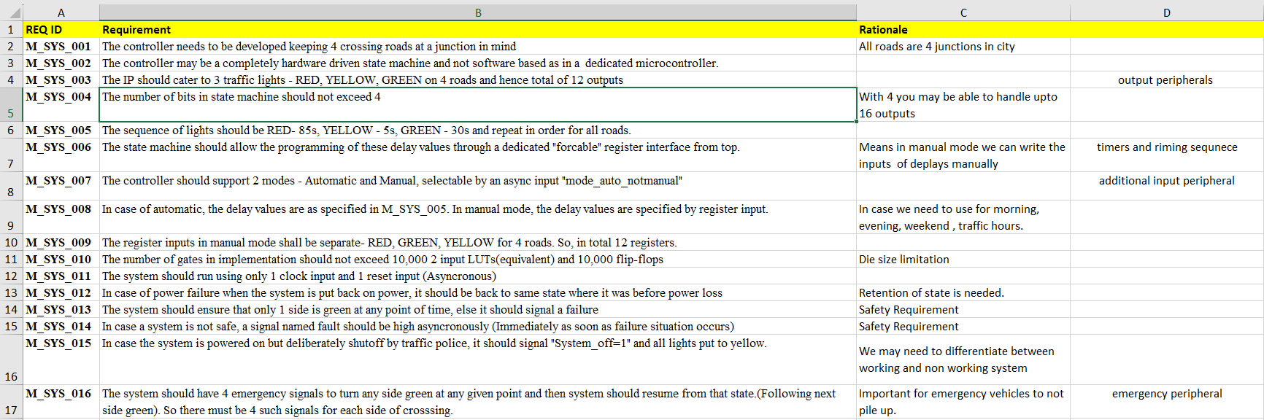
Marketing Requirements
Marketing tags that are required for traceability
Rationale is all about why we need this requirement
Detailed description of requirements

Slide 16
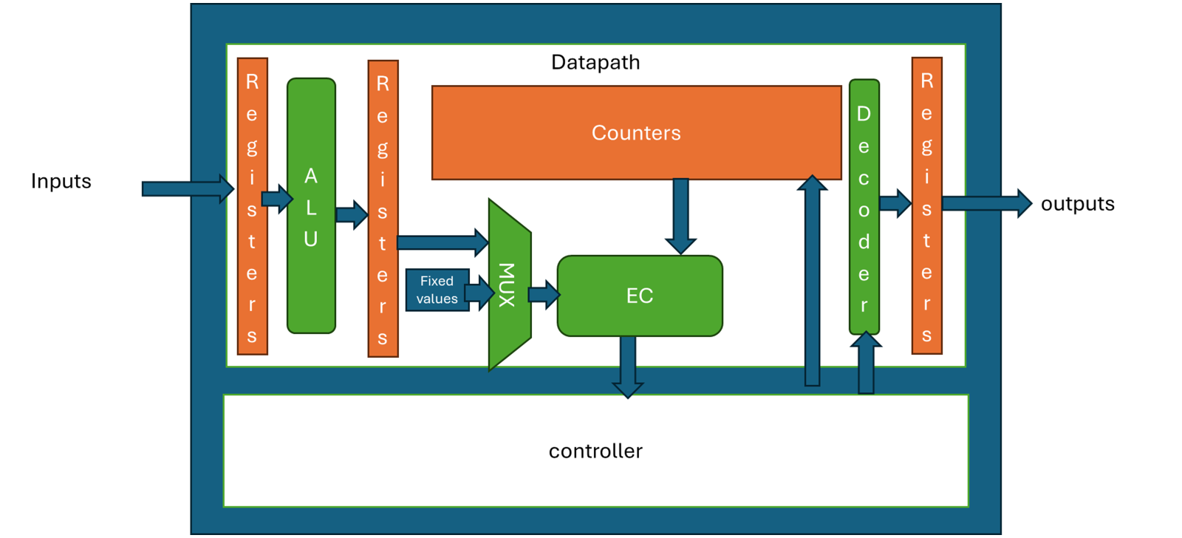
Approach for the system design

Slide 17
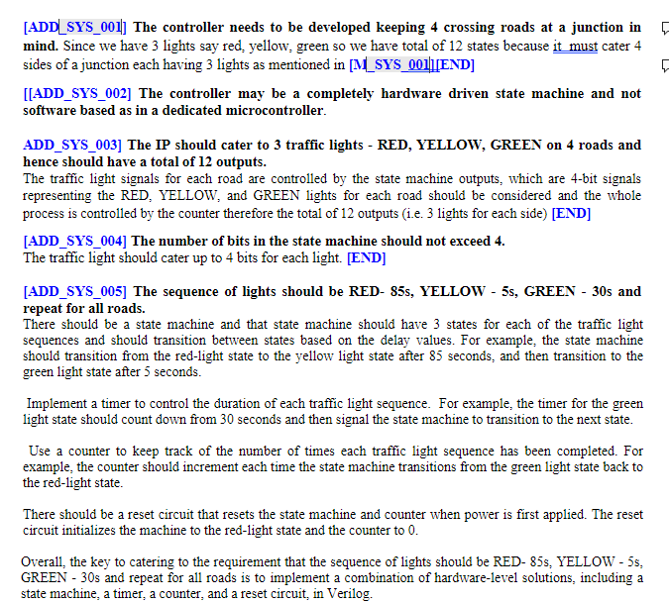
System Requirement
ADD tags corresponding to every marketing requirement always ended with keyword END
Examples of writing the requirements

Slide 18
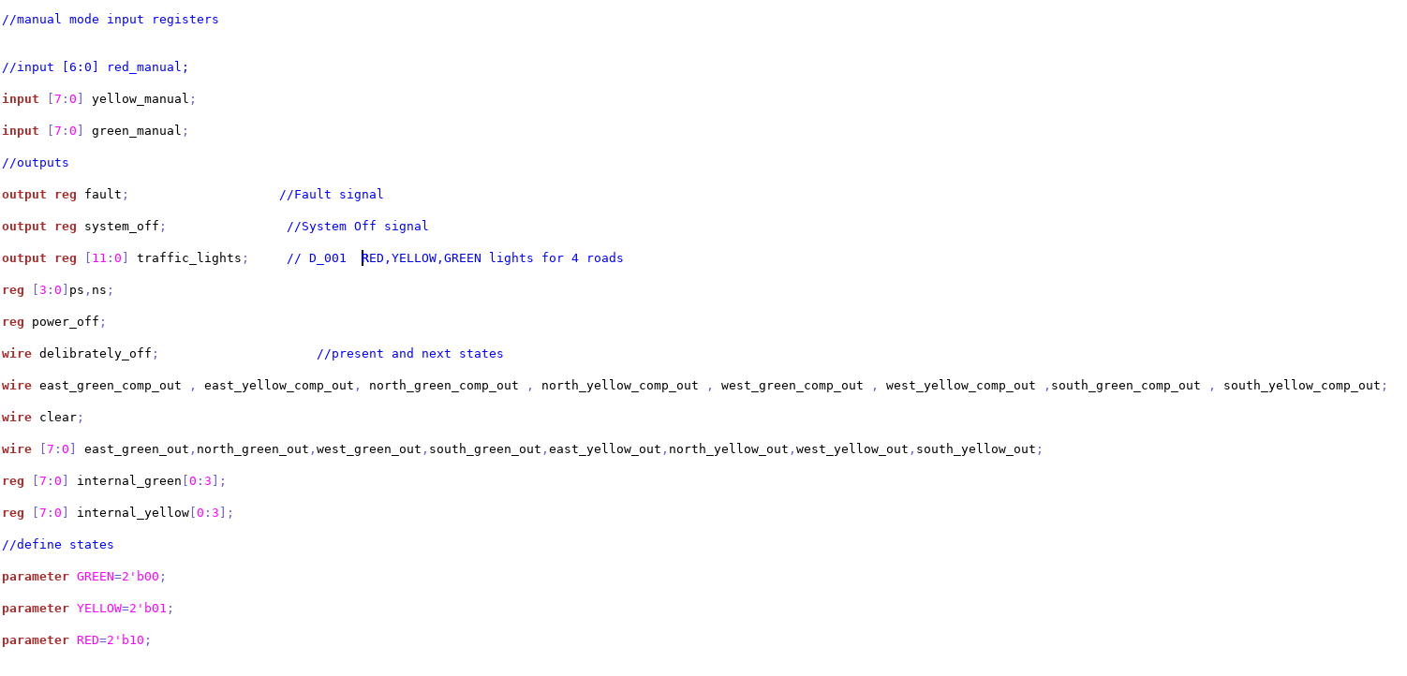
RTL Design tags
Design tag for a requirement

Slide 19
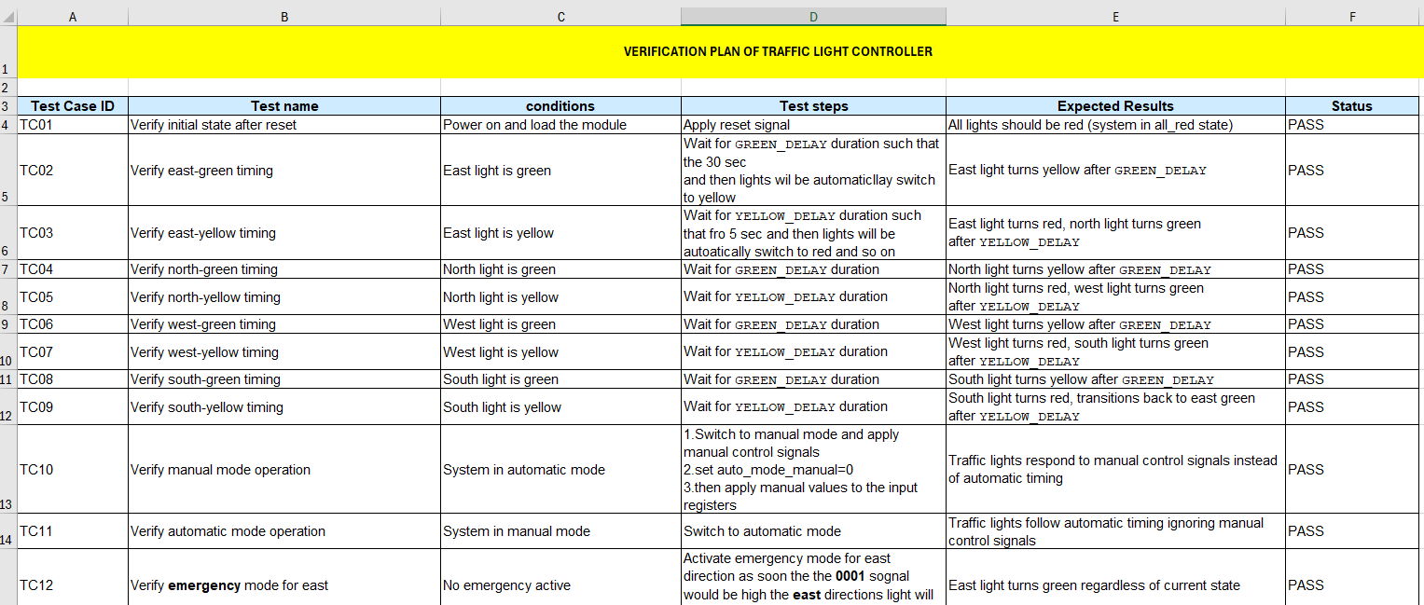
Verification plan
A unique identifier for each requirement that needs to be verified
What we did to test the requirement
The results we are expecting
A detailed description of the feature or requirement.
The current status of the verification effort (e.g., Not Started, In Progress, Blocked, Completed).

Slide 20
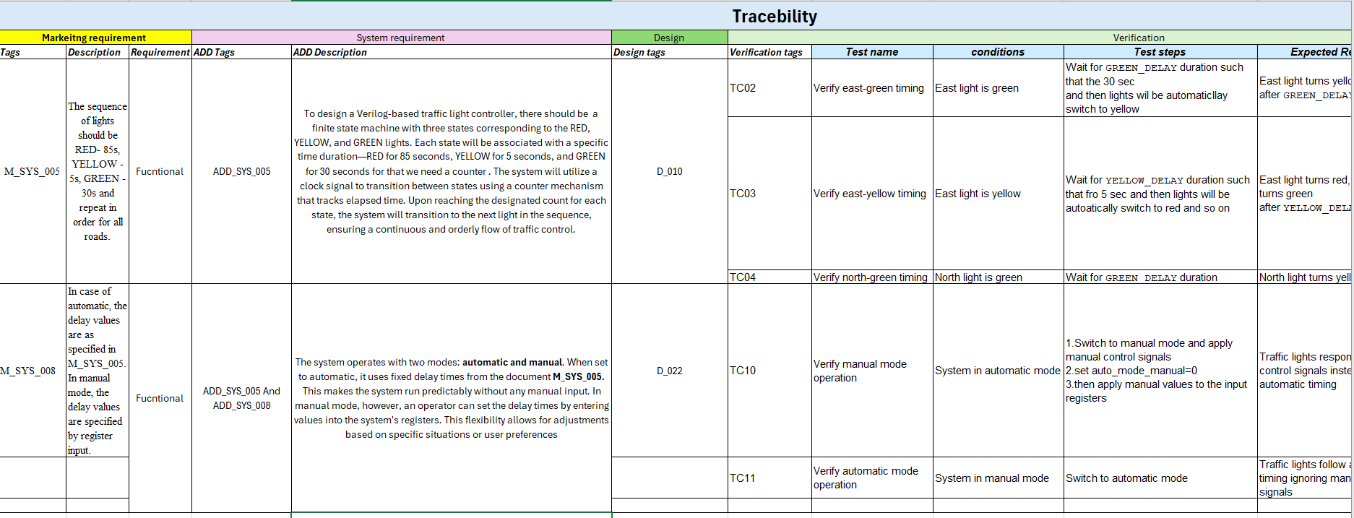
Traceability

Slide 21
What’s next with JAMA?

Slide 22
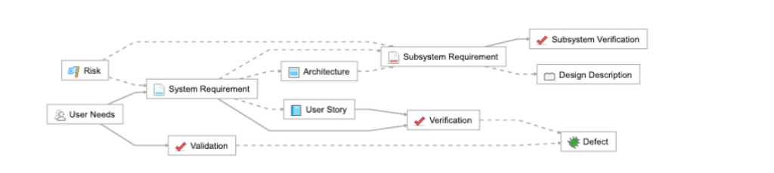
JAMA TRACEABILITY
The following diagram is a typical relationship model in Jama Connect that adheres to a Systems Engineering Methodology (SEM).
In it, a box represents a single item type, and lines represent relationships
BENEFITS OF ESTABLISHING RELATIONSHIPS
Allocation .
Traceability.
Verification

Slide 23
Further Queries
Does Jama have that feature of triggering the changes done during the project?
How do we ensure the correctness of tags linked with each other?
Implementation is not visible to non-designers?

